Slide 1
Course 1: Supervised Machine Learning: Classification and Regression

Slide 2
What is ML? Ability of a machine to learn from the past experience without being explicity program.
Types:
Supervised Learning
Labeled data
feed test data in I/P label (X) -> O/P label (Y) mapping by seeing which it learns to give reasonably accurate prediction for a given I/P.
Eg; Ip (X) Op (Y)
ad, user info click? (0/1)
audio text
picture of frame defect? (0/1) visual inspection
1. Regression (predicting continuous values in a infinitely possible values)
2. Classification (predicting categories, from a small set of finite possible outcomes)

Slide 3
Unsupervised Learning
finding structure/pattern in unlabeled data.
grouping related data into clusters.
I/p not associated with any O/p label (Data only comes with i/p).
Types:
Clustering: Group similar data points together
Anomaly detection: Find unusual data points.
Dimensionality reduction: Compressing data into fewer numbers w/o losing info

Slide 4
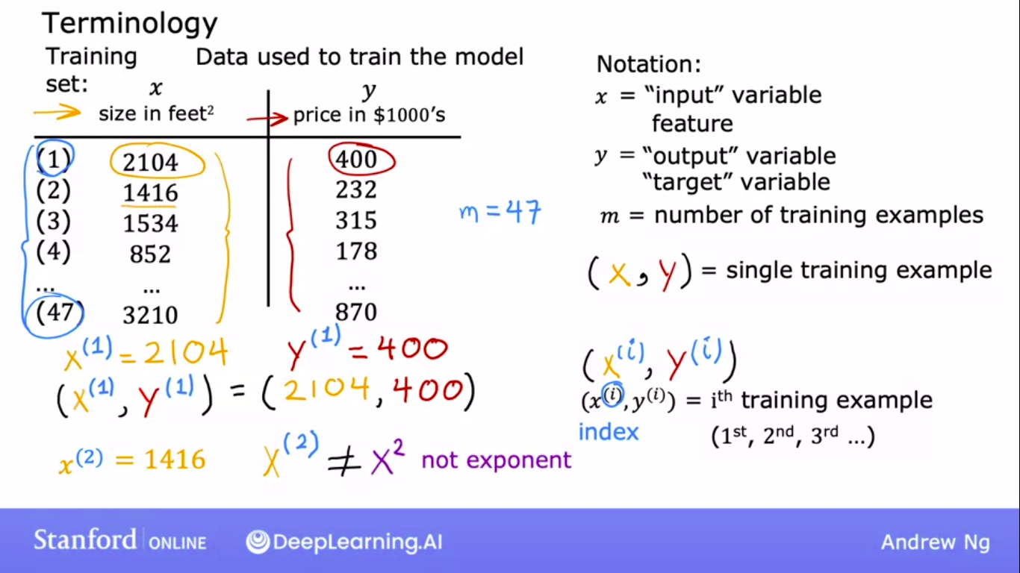
Supervised Learning algorithms
Linear regression:
Fitting a line to the data which is defined by a function
f_{w,b}(x) = wx + b
f (x) = wx + b
which predicts o/p (f (x)) for a given i/p once trained using training data set.

Slide 5
